Slide 1
Supervised model
Handling simple non-linearity

Slide 2
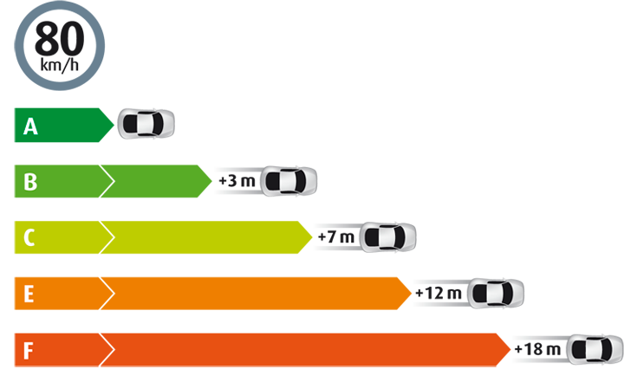
Non – linear transformation of data - Example
American Automobile Association (AAA) publishes data that the relationship between average stopping distance and the speed of car

Slide 4
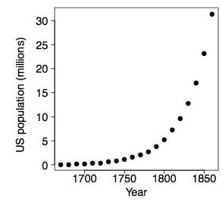
US population from 1670 - 1860

Slide 5
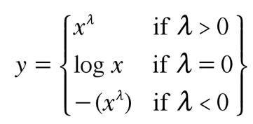
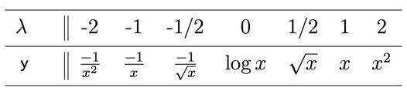
Tukey’s ladder of transformation
y = b₀ + b₁X^{λ}
or y^{λ} = b₀ + b₁X

Slide 6
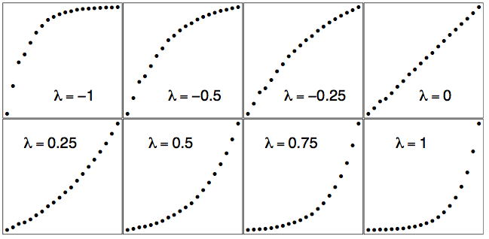
Tukey’s ladder of transformation

Slide 7
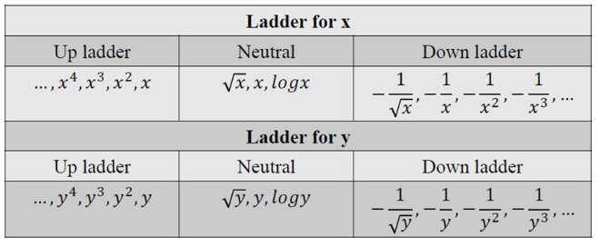
Tukey’s ladder of transformation

Slide 8
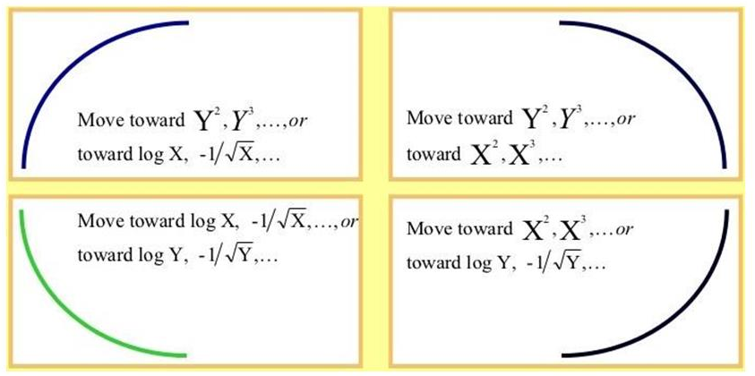
Tukey’s ladder of transformation

Slide 9
The Central Tendencies
The spread of the data in a dataset could be studied using
_______
◘ Interquartile range
◘ Variance
◘ Standard Deviation
◘ Range (max-min)
◘ All of the above

Slide 10
The Central Tendencies
Find second quartile for 25,36,12,87,15,32
◘ 48.5
◘ 49.5
◘ 48
◘ 49

Slide 11
The Central Tendencies
Which plot analyses interquartile range better:
◘ Scatterplot
◘ Histogram
◘ Lineplot
◘ Boxplot
◘ All of the above

Slide 12
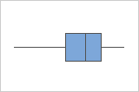
The Central Tendencies
What term would best describe the shape of the given boxplot?
◘ Symmetric
◘ Skewed with right tail
◘ Skewed with left tail
◘ Normal

Slide 13
The Central Tendencies
A sample of 600 Chennai households is selected and several variables are recorded. Which of the following statements is correct?
◘ Socioeconomic status (recorded as “low income”, “middle income”, or “high income”) is nominal level data
◘ The number of people living in a household is a discrete variable
◘ The primary language spoken in the household is ordinal level
data (recorded as “Tamil”, “Malayalam” etc)

Slide 14
The Central Tendencies
We studied Quartiles in depth and mentioned Deciles and Percentiles in passing. However, just as Quartiles divide data into 4 equal parts, Deciles divide it into 10 equal parts and Percentiles into 100 equal parts.
Given the above, find the 25th , 50th , 75th and the 90th percentiles for the top 16 global marketing sectors for advertising spending for a recent year according to Advertising Age. Also, find Q2 and IQR. Data in next slide.

Slide 15
Sector | Ad spending (in $ million)
Automotive | 22195
Personal Care | 19526
Entertainment and Media | 9538
Food | 7793
Drugs | 7707
Electronic | 4023
Soft Drinks | 3916
Retail | 3576
Restaurants | 3571
Cleaners | 3553
Computers | 3247
Telephone | 2448
Financial | 2433
Beer, Wine and Liquor | 2050
Candy | 1137
Toys | 699

Slide 16
The Central Tendencies
N = 16
90th percentile = $\left(p∗\frac{n−1}{100}+1\right)$
= $\frac{90\left(16 −1\right)}{100}+1$
= 14.5

Slide 17
Probability Basics

Slide 18
Understanding Probability
Consider the following statements. How do you interpret “probability” in each one of those? And how is it computed?
• Coin Toss – Probability of Head is ½
• Weather – Probability of thunderstorm tomorrow is 25%
• Cricket– India has only a 60% chance to win without Dhoni

Slide 19
Probability vs Statistics
• Probability – Predict the likelihood of a future event
• Statistics – Analyze the past events
Questions addressed -
• Probability – What will happen in a given ideal world?
• Statistics – How ideal is the world?

Slide 20
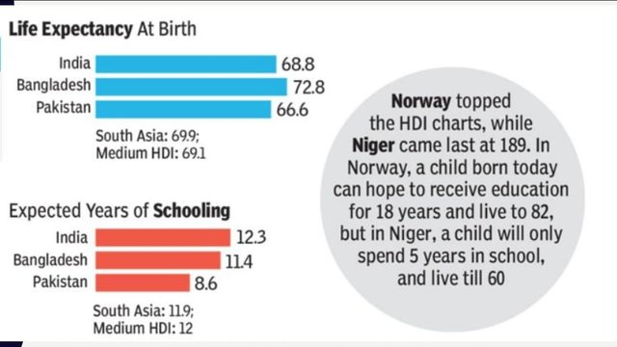
Probability - Applications
Insurance industry uses probabilities in actuarial tables for setting premiums and coverage.

Slide 21
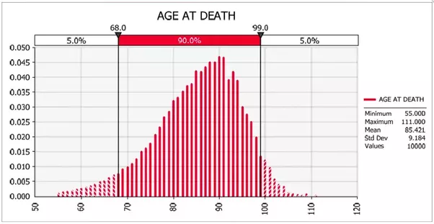
Probability - Applications

Slide 22
Probability - Applications
Medical Decisions – Success rate of the operation which is nothing but probability rate.
Weather – Probability of rainfall
Life Expectancy – Number of years a person can live
Manufacturing/Aerospace – Prevent major breakdowns
Business – Deciding on a business proposal based on probability of success vs cost
Risk Evaluation – Scenario analysis
Games – The probability of India winning most of the gold medals in Olympics.

Slide 23
Assigning Probabilities
Classical Method – A priori or Theoretical
Probability can be determined prior to conducting any experiment.
$$P\left(E\right)=\frac{\# of outcomes in which the even occurs}{total possible \# of outcomes}$$
Example: Tossing of a fair die

Slide 24
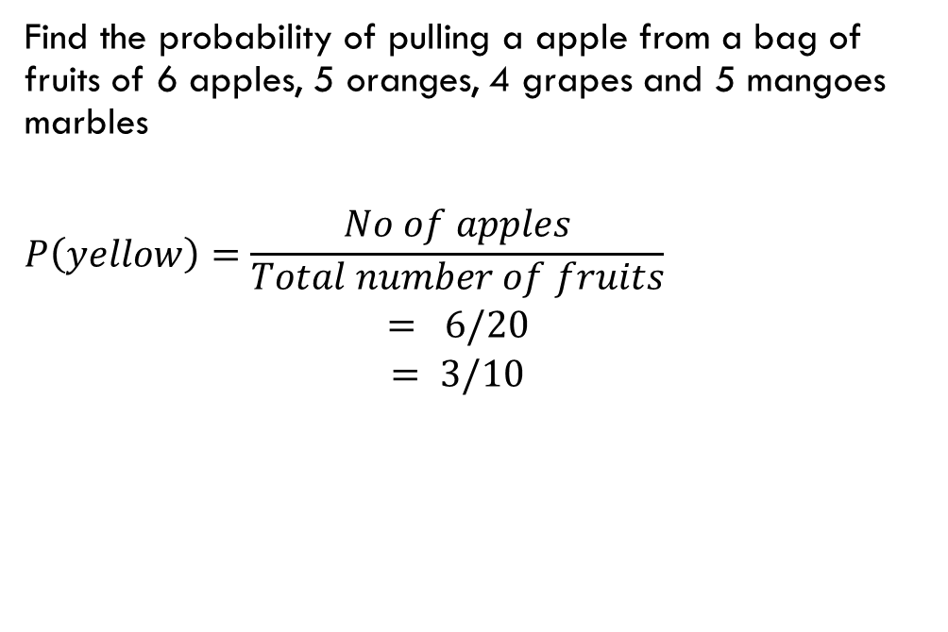
Computing A priori Probability
Find the probability of pulling a apple from a bag of fruits of 6 apples, 5 oranges, 4 grapes and 5 mangoes marbles
$$P\left(yellow\right)=\frac{No of apples}{\begin{aligned}Total number of fruits \\ = 6/20 \\ = 3/10\end{aligned}}$$

Slide 25
Computing probability
There are two concentric circles, The circumference of a circle is 36π. Contained in that circle is a smaller circle with an area of 16π. A point is selected at random from inside the larger circle. What is probability that the point also in the same circle.
Area of smaller circle = 16 π
Area of larger circle = $π ∗ {\left(\frac{36π}{2π}\right)}^{2}$
= 324 π
$$P\left(point in small circle \right)=\frac{Area of Large circle}{Area of small circle}$$
$=\text{16}\text{π}\text{/324}\text{π}$

Slide 26
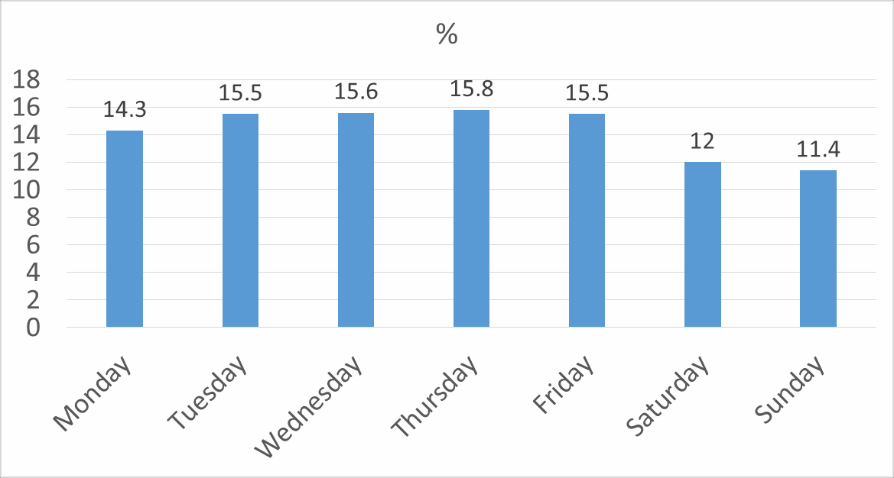

Assigning Probabilities
What is the probability of a baby being born on a Wednesday?
A-priori probability = $\frac{1}{7}=14.3\%$
Data from “Risks of Stillbirth and Early Neonatal Death by Day of Week”, by Zhong-Cheng Luo, Shiliang Liu, Russell Wilkins, and Michael S. Kramer, for the Fetal and Infant Health Study Group of the Canadian Perinatal Surveillance System. Data of 3,239,972 births in Canada between 1985 and 1998. The reported percentages do not add up to 100% due to rounding.

Slide 27
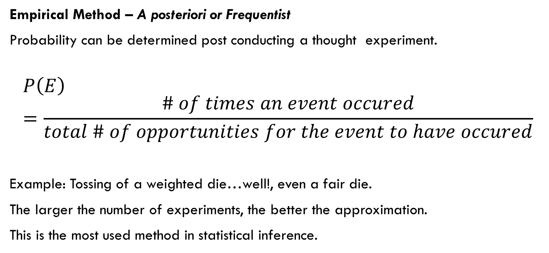
Assigning Probabilities
Empirical Method – A posteriori or Frequentist
Probability can be determined post conducting a thought experiment.
$$P\left(E\right)=\frac{\# of times an event occured}{total \# of opportunities for the event to have occured}$$
Example: Tossing of a weighted die…well!, even a fair die.
The larger the number of experiments, the better the approximation.
This is the most used method in statistical inference.

Slide 28
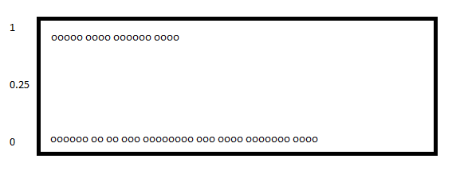
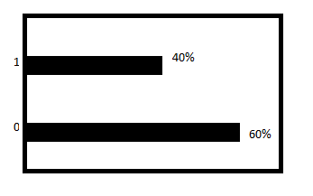
Assigning Probabilities
Empirical Method – A posteriori or Frequentist
Probability of getting heads for 4 times when tossing a coin 10 times.
Head – 1 Tails -0

Slide 29
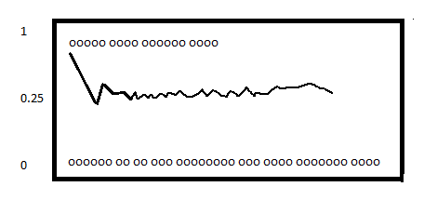
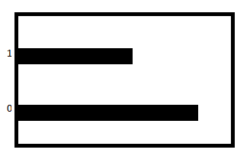
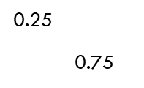
Assigning Probabilities
Empirical Method – A posteriori or Frequentist
Tossing the coin more 10 times, now the probability of getting 4 heads

Slide 30
Assigning Probabilities
Empirical Method – A posteriori or Frequentist
Averages over the long run
P(head) = 0.25
0.25
0.75

Slide 31
Assigning Probabilities
Subjective Method
Based on feelings, insights, knowledge, etc. of a person.
What is the probability of India winning the upcoming World cup 2019?

Slide 32
Probability - Terminology
Sample Space – Set of all possible outcomes, denoted S.
Example:
After 2 coin tosses, the set of all possible outcomes are {HH, HT, TH, TT}
Event – A subset of the sample space.
An Event of interest might be - HH

Slide 33

Probability - Rules
$P\left(s\right)=1$ $0≤P\left(A\right)≤1$ $P\left(A or B\right)=P\left(A\right)+P(B)$
Area of the rectangle denotes sample space, and since probability is associated with area, it cannot be negative.
Mutually Exclusive – If event A happens, event B cannot.
S
S
S
A
A
B
A and B are mutually exclusive

Slide 34
Probabilities Rules
S
$$P\left(A or B\right)=P\left(A\right)+P\left(B\right) −P(A and B)$$
Example
Event A – Customers who default on loans
Event B – Customers who are High Net Worth Individuals
A
B

Slide 35
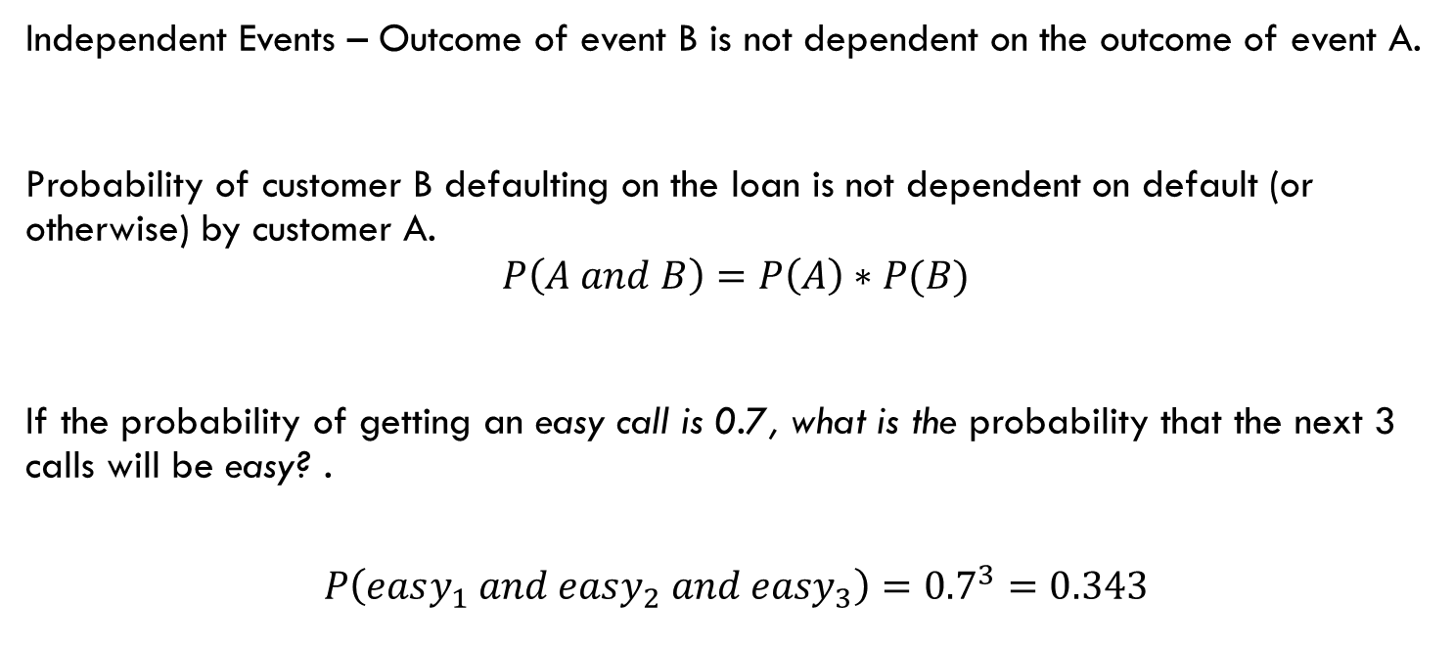
Probability - Rules
Independent Events – Outcome of event B is not dependent on the outcome of event A.
Probability of customer B defaulting on the loan is not dependent on default (or otherwise) by customer A.
$$P\left(A and B\right)=P\left(A\right)∗P(B)$$
If the probability of getting an easy call is 0.7, what is the probability that the next 3 calls will be easy? .
$$P\left(easy_{1} and easy_{2} and easy_{3}\right)={0.7}^{3}=0.343$$

Slide 36
Probability Question
A basketball team is down by 2 points with only a few seconds remaining in the game. Given that:
• Chance of making a 2-point shot to tie the game = 50%
• Chance of winning in overtime = 50%
• Chance of making a 3-point shot to win the game = 30%
What should the
coach do: go for 2point
or 3-point shot?
What are the
assumptions, if any?

Slide 37
Probability - Types
Customer-Id | Customer Name | Age | Default
846596 | Srikanth | 28 | Yes
846597 | Raghu | 25 | No
846598 | Ramya | 24 | No
… | … | … | …

Slide 38
Probability - Types
Contingency table summarizing 2 variables, Loan Default
and Age:
 |  | Age
 |  | Young | Middle-aged | Old | Total
Loan Defaults | No | 5252 | 13684 | 130 | 19066
 | Yes | 1793 | 2426 | 60 | 4279
 | Total | 7045 | 16110 | 190 | 23345

Slide 39
Probability - Types
Convert it into probabilities
 |  | Age
 |  | Young | Middle-aged | Old | Total
Loan Defaults | No | 0.225 | 0.586 | 0.005 | 0.816
 | Yes | 0.077 | 0.104 | 0.003 | 0.184
 | Total | 0.302 | 0.690 | 0.008 | 1.000

Slide 40
Probability – Types Marginal Probability
 |  | Age
 |  | Young | Middle-aged | Old | Total
Loan Defaults | No | 0.225 | 0.586 | 0.005 | 0.816
 | Yes | 0.077 | 0.104 | 0.003 | 0.184
 | Total | 0.302 | 0.690 | 0.008 | 1.000
Probability describing a single attribute
P(Middle) = 0.690
P(old) = 0.008
Marginal Probability
S
A

Slide 41
Probability – Types JOINT PROBABILITY
 |  | Age
 |  | Young | Middle-aged | Old | Total
Loan Defaults | No | 0.225 | 0.586 | 0.005 | 0.816
 | Yes | 0.077 | 0.104 | 0.003 | 0.184
 | Total | 0.302 | 0.690 | 0.008 | 1.000
Probability describing a combination of
attribute
P(Yes and old) = 0.003
Joint Probability
S
A
B
Yes
Old

Slide 42
Probability – Types UNION PROBABILITY
 |  | Age
 |  | Young | Middle-aged | Old | Total
Loan Defaults | No | 0.225 | 0.586 | 0.005 | 0.816
 | Yes | 0.077 | 0.104 | 0.003 | 0.184
 | Total | 0.302 | 0.690 | 0.008 | 1.000
P(Yes or old) = P(Yes) + P(old) – P(Yes and old)
= 0.184 + 0.008 – 0.003
= 0.189
S
A
B
Yes
Old

Slide 43

Probability - Types
Conditional Probability
Probability of A occurring given that B has occurred.
The sample space is restricted to a single row or column.
This makes rest of the sample space irrelevant.
Probability, i.e., $P\left(A | B\right)=\frac{P\left(A and B\right)}{P(B)}$
S
A
B
B
S

Slide 44
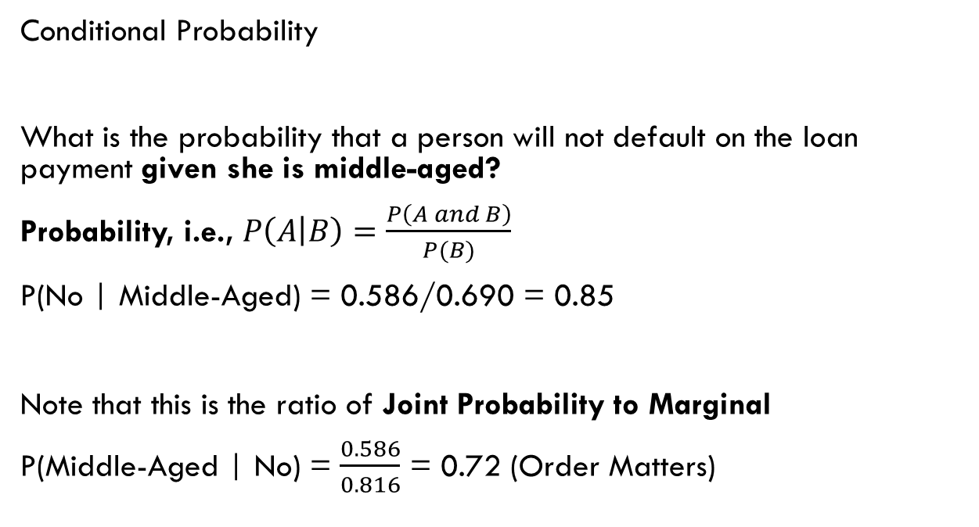
Probability - Types
 |  | Age
 |  | Young | Middle-aged | Old | Total
Loan Defaults | No | 0.225 | 0.586 | 0.005 | 0.816
 | Yes | 0.077 | 0.104 | 0.003 | 0.184
 | Total | 0.302 | 0.690 | 0.008 | 1.000
Conditional Probability
What is the probability that a person will not default on the loan payment given she is middle-aged?
Probability, i.e., $P\left(A | B\right)=\frac{P\left(A and B\right)}{P(B)}$
P(No | Middle-Aged) = 0.586/0.690 = 0.85
Note that this is the ratio of Joint Probability to Marginal
P(Middle-Aged | No) = $\frac{0.586}{0.816}$ = 0.72 (Order Matters)

Slide 45














 |  | Age
 |  | Young | Middle-aged | Old | Total
Loan Defaults | No | 5252 | 13684 | 130 | 19066
 | Yes | 1793 | 2426 | 60 | 4279
 | Total | 7045 | 16110 | 190 | 23345
 | Age
 | Young | Middle-aged | Old | Total
 | 0.225 | 0.586 | 0.005 | 0.816
 | 0.077 | 0.104 | 0.003 | 0.183
 | 0.302 | 0.690 | 0.008 | 1.000
No – Non-defaulter
Yes - Defaulter
Young
$$P\left(Young\right|No)$$
$\frac{5,252}{19,066}$= 0.275
$\frac{13,684}{19,066}$= 0.717
$\frac{19,066}{23,345}$= 0.816
No
Middle
$$P\left(Middle\right|No)$$
$\frac{130}{19,066}$= 0.0068
Old
$$P\left(old\right|No)$$
Loan
Defaulter
Young
$$P\left(Young\right|Yes)$$
$\frac{1,793}{4,279}$ = 0.419
$\frac{2,426}{4,279}$=0.566
$\frac{4279}{23345}$=0.183
Yes
Middle
$$P\left(Middle\right|Yes)$$
$\frac{60}{4279}$= 0.014
Old
$$P\left(old\right|Yes)$$

Slide 46














Young
$$P\left(Young\right|No)$$
$\frac{5,252}{19,066}$= 0.275
$\frac{13,684}{19,066}$= 0.717
$\frac{19,066}{23,345}$= 0.816
No
Middle
$$P\left(Middle\right|No)$$
$\frac{130}{19,066}$= 0.0068
Old
$$P\left(old\right|No)$$
Loan
Defaulter
Young
$$P\left(Young\right|Yes)$$
$\frac{1,793}{4,279}$ = 0.419
$\frac{2,426}{4,279}$=0.566
$\frac{4279}{23345}$=0.183
Yes
Middle
$$P\left(Middle\right|Yes)$$
$\frac{60}{4279}$= 0.014
Old
$$P\left(old\right|Yes)$$
P(Old and Yes)
P(Yes and Old)
P(Old)
P(Yes)
P(Old | Yes)
P(Yes | Old)
P(Young | No)

Slide 47





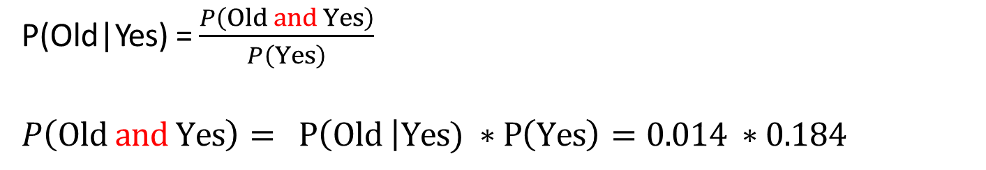









P(Old and Yes)
Young
$$P\left(Young\right|No)$$
$\frac{5,252}{19,066}$= 0.275
$\frac{13,684}{19,066}$= 0.717
$\frac{19,066}{23,345}$= 0.816
No
Middle
$$P\left(Middle\right|No)$$
$\frac{130}{19,066}$= 0.0068
Old
$$P\left(old\right|No)$$
Loan
Defaulter
Young
$$P\left(Young\right|Yes)$$
$\frac{1,793}{4,279}$ = 0.419
$\frac{2,426}{4,279}$=0.566
$\frac{4279}{23345}$=0.183
Yes
Middle
$$P\left(Middle\right|Yes)$$
$\frac{60}{4279}$= 0.014
Old
$$P\left(old\right|Yes)$$
P(Old|Yes) = $\frac{P\left(Old and Yes\right)}{P\left(Yes\right)}$
$P\left(Old and Yes\right)= P\left(Old \right|Yes) ∗P\left(Yes\right)=0.014 ∗0.184$

Slide 48





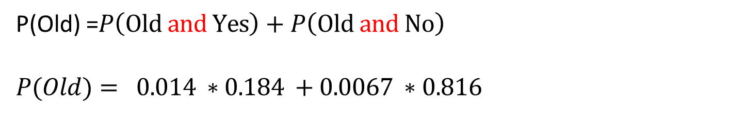









P(Old)
Young
$$P\left(Young\right|No)$$
$\frac{5,252}{19,066}$= 0.275
$\frac{13,684}{19,066}$= 0.717
$\frac{19,066}{23,345}$= 0.816
No
Middle
$$P\left(Middle\right|No)$$
$\frac{130}{19,066}$= 0.0068
Old
$$P\left(old\right|No)$$
Loan
Defaulter
Young
$$P\left(Young\right|Yes)$$
$\frac{1,793}{4,279}$ = 0.419
$\frac{2,426}{4,279}$=0.566
$\frac{4279}{23345}$=0.183
Yes
Middle
$$P\left(Middle\right|Yes)$$
$\frac{60}{4279}$= 0.014
Old
$$P\left(old\right|Yes)$$
P(Old) =$P\left(Old and Yes\right)+P\left(Old and No\right)$
$P(Old)= 0.014 ∗0.184 +0.0067 ∗0.816$

Slide 49














Young
$$P\left(Young\right|No)$$
$\frac{5,252}{19,066}$= 0.275
$\frac{13,684}{19,066}$= 0.717
$\frac{19,066}{23,345}$= 0.816
No
Middle
$$P\left(Middle\right|No)$$
$\frac{130}{19,066}$= 0.0068
Old
$$P\left(old\right|No)$$
Loan
Defaulter
Young
$$P\left(Young\right|Yes)$$
$\frac{1,793}{4,279}$ = 0.419
$\frac{2,426}{4,279}$=0.566
$\frac{4279}{23345}$=0.183
Yes
Middle
$$P\left(Middle\right|Yes)$$
$\frac{60}{4279}$= 0.014
Old
$$P\left(old\right|Yes)$$
P(Old and Yes)
P(Yes and Old)
P(Old)
P(Yes)
P(Old | Yes)
P(Yes | Old)
P(Young | No)

Slide 50
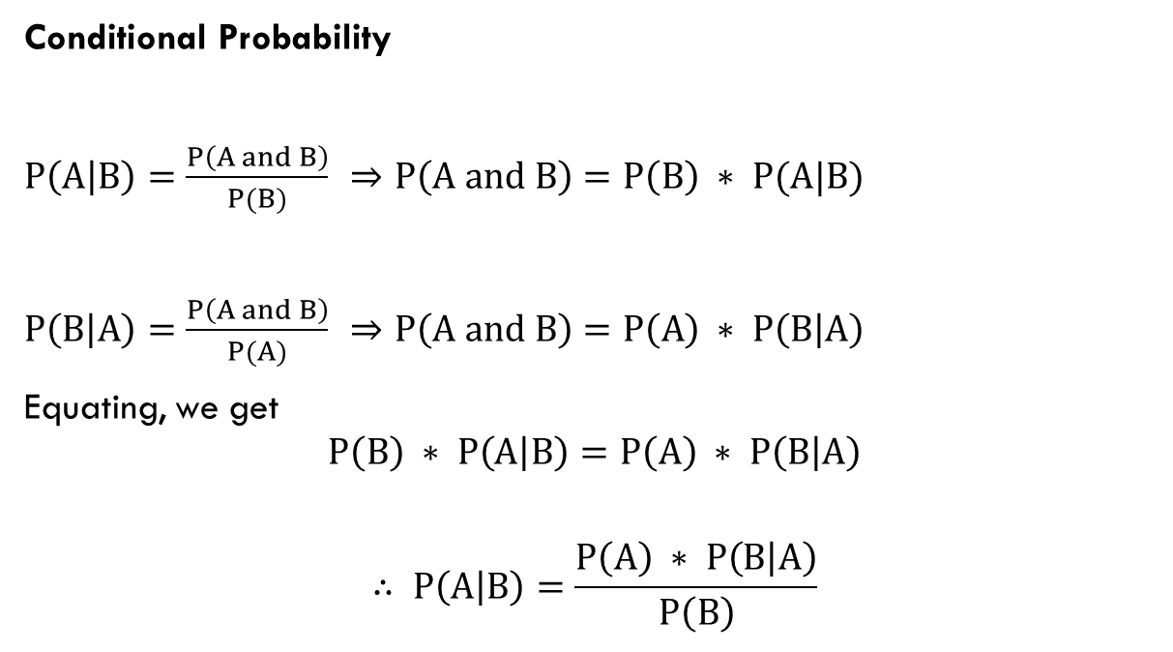
Probability - Types
Conditional Probability
$P\left(A | B\right)=\frac{P\left(A and B\right)}{P(B)}$ $⇒P\left(A and B\right)=P\left(B\right) ∗ P(A|B)$
$P\left(B | A\right)=\frac{P\left(A and B\right)}{P(A)}$ $⇒P\left(A and B\right)=P\left(A\right) ∗ P\left(B | A\right)$
Equating, we get
$$P\left(B\right) ∗ P\left(A | B\right)=P\left(A\right) ∗ P\left(B | A\right)$$
$$∴ P\left(A | B\right)=\frac{P\left(A\right) ∗ P\left(B | A\right)}{P\left(B\right)}$$

Slide 51
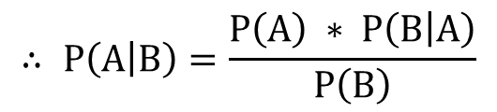
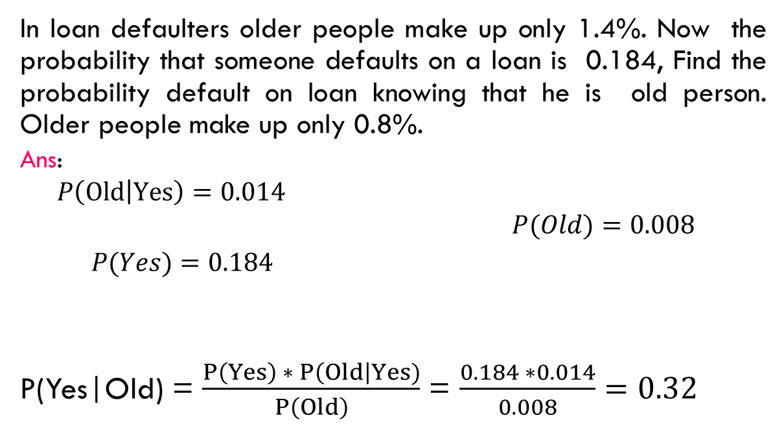
Probability - Types
$$∴ P\left(A | B\right)=\frac{P\left(A\right) ∗ P\left(B | A\right)}{P\left(B\right)}$$
In loan defaulters older people make up only 1.4%. Now the probability that someone defaults on a loan is 0.184, Find the probability default on loan knowing that he is old person. Older people make up only 0.8%.
Ans:
$P\left(Old | Yes\right)=0.014$
$P(Old)=0.008$
$P(Yes)=0.184$
P(Yes|Old) = $\frac{P\left(Yes\right) ∗ P\left(Old\right|Yes)}{P\left(Old\right)}$ = $\frac{0.184 ∗0.014}{0.008}=0.32$

Slide 52

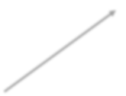

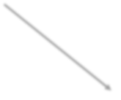


Generalized Probability Tree
A
P(B and A) = P(B) * P(A|B)
P(A|B)
B
P(B)
State each probability in English; note B’ means “not B”.
P(A’|B)
A’
P(B and A’) = P(B) * P(A’|B)
A
P(B’ and A) = P(B’) * P(A|B’)
P(B’)
P(A|B’)
B’
P(A’|B’)
A’
P(B’ and A’) = P(B’) * P(A’|B’)

Slide 53
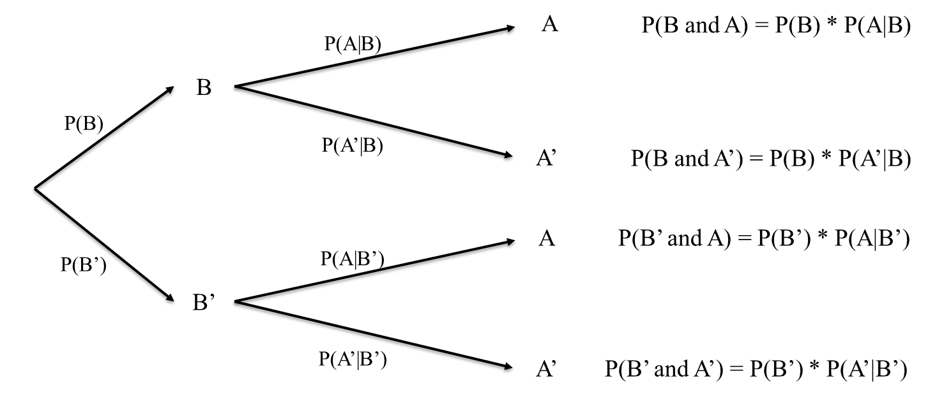
Conditional Probability → Bayes Theorem
Note B’ means “not B”
𝑃 𝐵 ∗ 𝑃(𝐴|𝐵)
𝑃 𝐴 𝐵 ∗ 𝑃(𝐵)
∗ 𝑃 𝐵 + 𝑃 𝐴 𝑛𝑜𝑡 𝐵
𝑃 𝐵 𝐴 =
=
𝑃(𝐴)
𝑃 𝐴 𝐵
∗ 𝑃(𝑛𝑜𝑡 𝐵)

Slide 54
Bayes’ Theorem
Case – Clinical trials
Epidemiologists claim that probability of breast cancer among Caucasian women in their mid-50s is 0.005. An established test identified people who had breast cancer and those that were healthy. A new mammography test in clinical trials has a probability of 0.85 for detecting cancer correctly. In women without breast cancer, it has a chance of 0.925 for a negative result. If a 55-year-old Caucasian woman tests positive for breast cancer, what is the probability that she in fact has breast cancer?

Slide 55
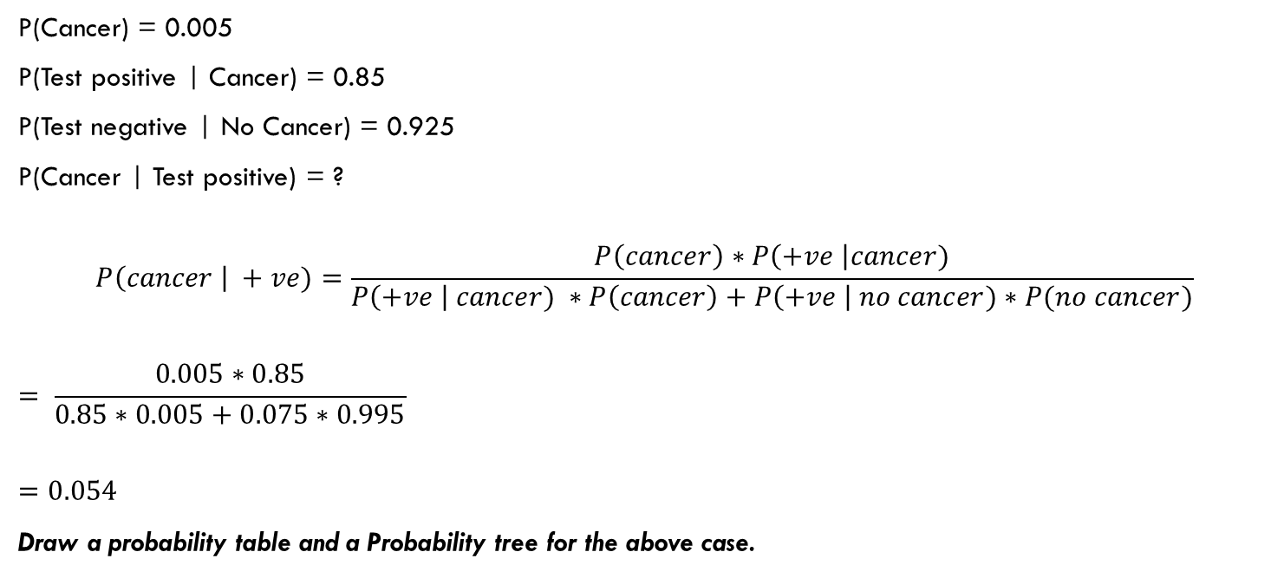
Case – Clinical trails
P(Cancer) = 0.005
P(Test positive | Cancer) = 0.85
P(Test negative | No Cancer) = 0.925
P(Cancer | Test positive) = ?
$$P\left(cancer \right| +ve)=\frac{P\left(cancer\right)∗P\left(+ve \right|cancer)}{P\left(+ve \right| cancer) ∗P\left(cancer\right)+P\left(+ve \right| no cancer)∗P(no cancer)}$$
$$= \frac{0.005∗0.85}{0.85∗0.005+0.075∗0.995}$$
$$=0.054$$
Draw a probability table and a Probability tree for the above case.

Slide 56


Bayes’ Theorem $⇒$Spam filtering
SpamAssassin works by having users train the system. It looks for patterns in the words in emails marked as spam by the user. For example, it may have learned that the word “free” appears in 20% of the mails marked as spam, i.e., P(Free | Spam) = 0.20. Assuming 0.1% of non-spam mail includes the word “free” and 50% of all mails received by the user are spam, find the probability that a mail is spam if the word “free” appears in it.

Slide 57
Bayes’ Theorem
P(Spam) = 0.50
P(Free | Spam) = 0.20 (aka Prior Probability)
P(Free | No spam) = 0.001
P(Spam | Free) = ? (aka Posterior or Revised Probability)
𝑃 𝑆𝑝𝑎𝑚 ∗ 𝑃(𝐹𝑟𝑒𝑒|𝑆𝑝𝑎𝑚)
𝑃 𝑆𝑝𝑎𝑚 𝐹𝑟𝑒𝑒 =
𝑃 𝐹𝑟𝑒𝑒 𝑆𝑝𝑎𝑚 ∗ 𝑃 𝑆𝑝𝑎𝑚 + 𝑃 𝐹𝑟𝑒𝑒 𝑁𝑜 𝑠𝑝𝑎𝑚 ∗ 𝑃(𝑁𝑜 𝑠𝑝𝑎𝑚)
0.5 ∗ 0.2 0.1
=
= = 0.995
0.2 ∗ 0.5 + 0.001 ∗ 0.5 0.1005
This helps the spam filter automatically classify the messages as spam.

Slide 58
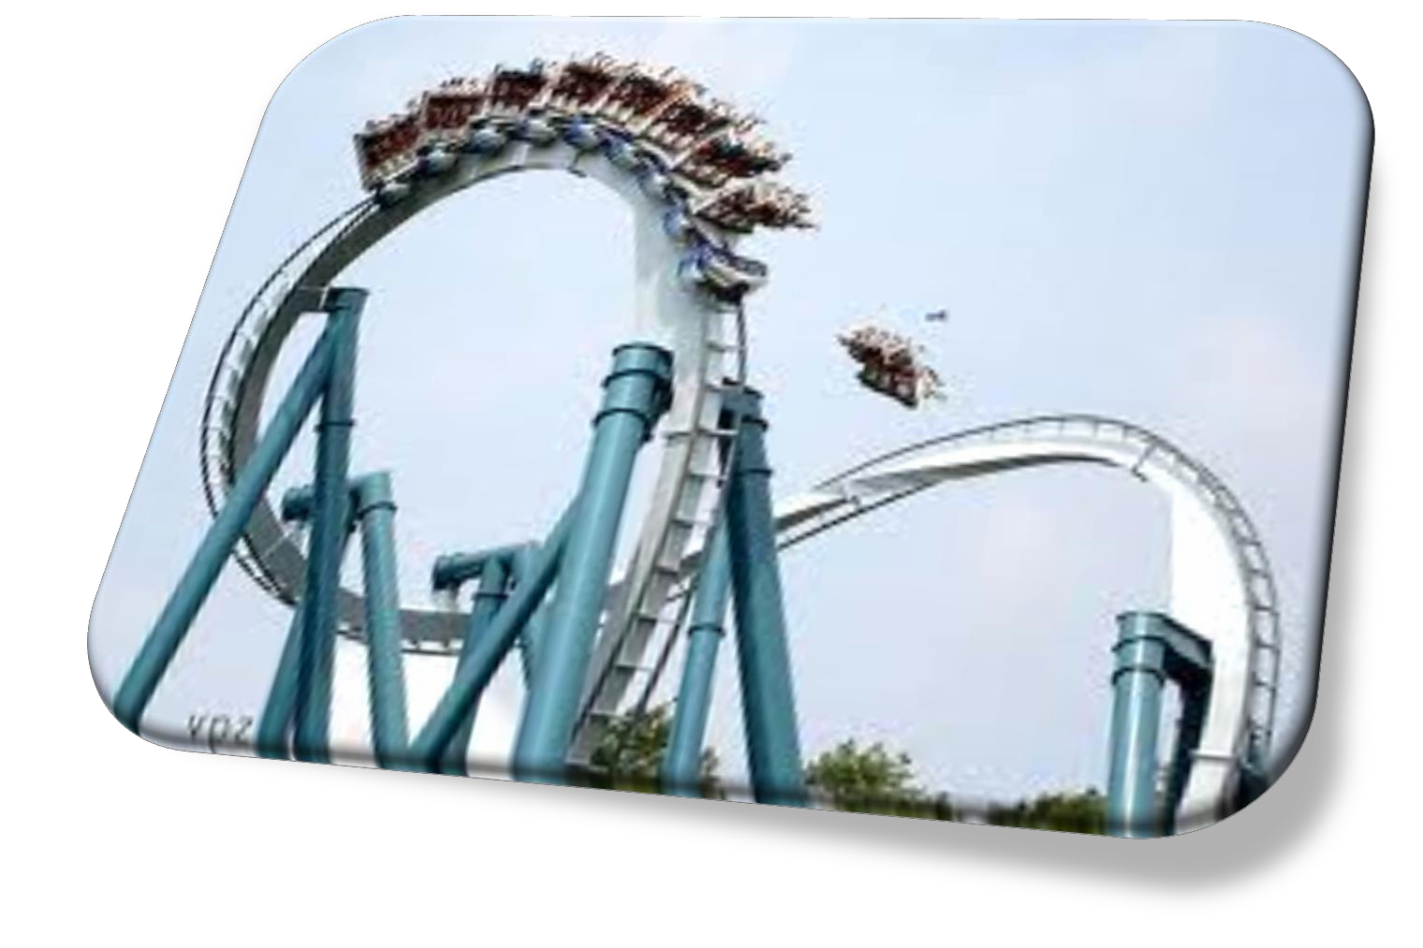
How Good is Your Classification

Slide 59
Confusion Matrix
Spam filtering |  | Predicted |  | Total
 |  | Positive | Negative
Actual | Positive | 952 | 526 | 1478
 | Negative | 167 | 3025 | 3192
Total |  | 1119 | 3551 | 4670
 |  | Predicted
 |  | Positive | Negative
Actual | Positive | True +ve | False –ve | Recall/Sensitivity/True Positive Rate (Minimize False –ve)
 | Negative | False +ve | True –ve | Specificity/True Negative Rate (Minimize False +ve)
 |  | Precision |  | Accuracy, F₁ score

Slide 60

Confusion Matrix
$$Recall \left(sensitivity\right)=\frac{952}{1478}=0.644$$
Precision $=\frac{952}{1119}=0.851$
$$Accuracy =\frac{952+3025}{952+3025+526+167}=\frac{3977}{4670}=0.852$$
$$Spcificity=\frac{3025}{3025+167}=0.948$$
$$F_{1}=2 ∗\frac{Precision∗Recall}{Preceision+Recall}= \frac{2 ∗0.851 ∗0.644}{0.851+0.644}=0.733$$
Spam filtering |  | Predicted |  | Total
 |  | Positive | Negative
Actual | Positive | 952 | 526 | 1478
 | Negative | 167 | 3025 | 3192
Total |  | 1119 | 3551 | 4670
Which measure(s) is/are more important?

Slide 61
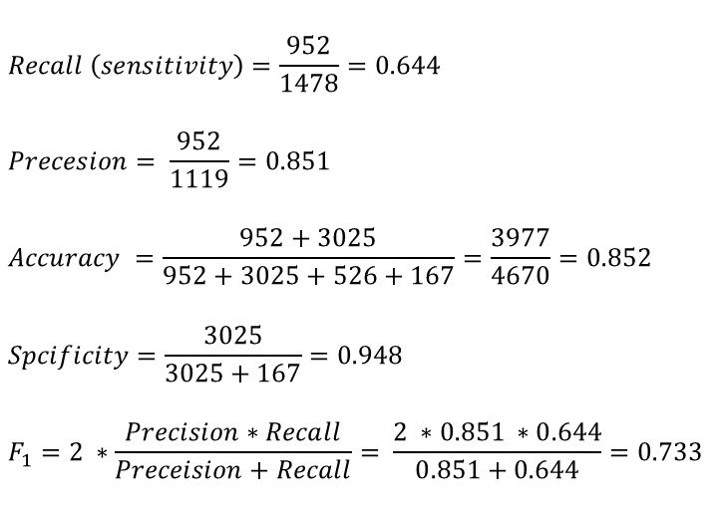
Confusion Matrix
Cancer |  | Predicted |  | Total
 |  | Positive | Negative
Actual | Positive | 952 | 526 | 1478
 | Negative | 167 | 3025 | 3192
Total |  | 1119 | 3551 | 4670
$$Recall \left(sensitivity\right)=\frac{952}{1478}=0.644$$
$$Precesion= \frac{952}{1119}=0.851$$
$$Accuracy =\frac{952+3025}{952+3025+526+167}=\frac{3977}{4670}=0.852$$
$$Spcificity=\frac{3025}{3025+167}=0.948$$
$$F_{1}=2 ∗\frac{Precision∗Recall}{Preceision+Recall}= \frac{2 ∗0.851 ∗0.644}{0.851+0.644}=0.733$$
Which measure(s) is/are more important?

